Slide 1
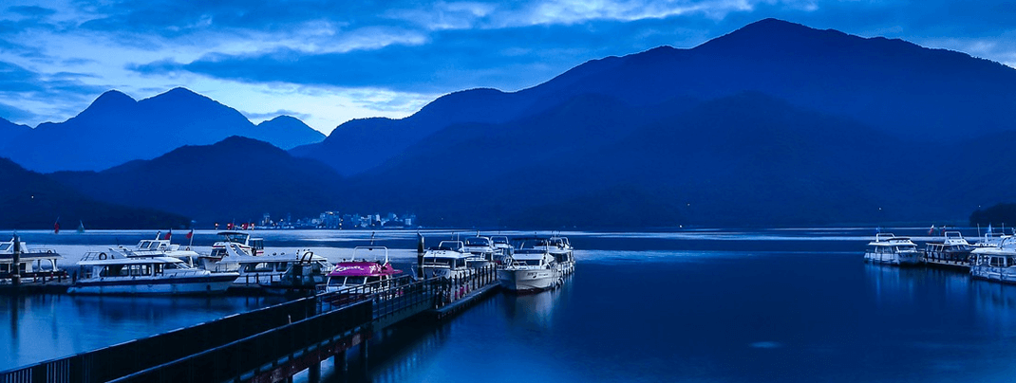
HW11_Sun Moon Lake
2022 Algorithm

Slide 2
Assignment Requirement
Sun Moon Lake is the second largest lake in Taiwan. It is also a famous tourist attraction.
Give you a 2D array which means the height of the mountains.
And count the total water volume in this array.
Note: If surrounding elements are higher then a element, then it will be a lake. The water volume of this lake is equal to (the lowest height of surrounding elements – height of this element)

Slide 3
Example 01
Input: {{2, 5, 3}, {7, 1, 6}, {9, 8, 4}}
Output: 4
Explanation:
2 | 5 | 3
7 | 1 | 6
9 | 8 | 4
Water volume = 5 – 1 = 4

Slide 4
Example 02
Input: {{1, 3, 2, 4, 5, 2}, {2, 1, 3, 2, 1, 4}, {2, 3, 4, 5, 7, 8}}
Output: 4
Explanation:
1 | 3 | 2 | 4 | 5 | 2
2 | 1 | 3 | 2 | 1 | 4
2 | 3 | 4 | 5 | 7 | 8
Water volume = (2 - 1) + (3 - 2) + (3 - 1)
= 1 + 1 + 2 = 4

Slide 5

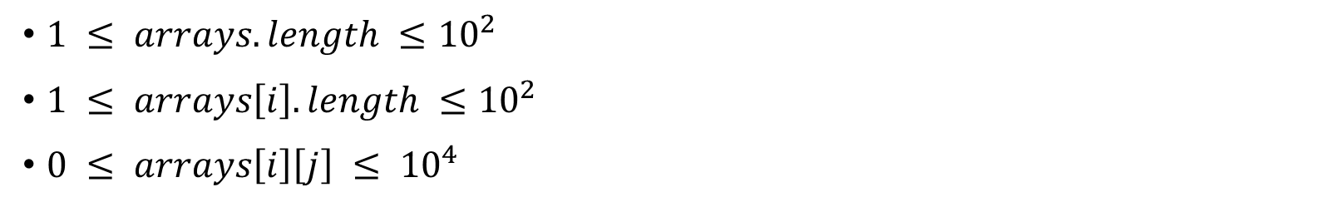
Constraints
$1 ≤ arrays.length ≤{10}^{2}$
$1 ≤ arrays\left[i\right].length ≤{10}^{2}$
$0 ≤ arrays\left[i\right]\left[j\right] ≤ {10}^{4}$
Don’t import anything in your program.
Please inherit from this abstract class:
Please name your class as HW11_學號_版本號

